Slide 1
UI Design: Wednesday Week 3
Dr. Jillian Aurisano
Plan for today:
Announcements/Course logistics
Learning and discovering UI features
Component breakdown activity
Notes:
So welcome to engineering visual interfaces for data science. I'm Dr Aurisano.
Thanks for finding the class on Zoom. Hopefully we will be in person again soon.
If anyone out there is comfortable turning on their cameras, that is lovely- then I feel like I am talking to students, rather than to myself.
Here’s our plan for today:
First I’m going to introduce myself, so you know a bit about me
Then we are going to get to know each other, in Zoom breakout rooms. This will give us a chance to make sure that Zoom breakout rooms work, and we all know how to access them.
Then, I am going to walk through the structure, and plan for the course. I want to make sure everyone knows how the course will work, and what to expect, and also a bit about why the course is designed this way.
Then I am going to introduce the class, and what the class is about. Since this is a new class, and one of just a few classes in human centered computing here at UC, I wanted to give an overview of the topic.
Then I have an introductory activity, which we will do in breakout rooms, and which I think will help motivate the discussion on Wednesday, and getting into the meat of the class.

Slide 2
Announcements / Course logistics
Small change in homework administration
I am going to leave homework assignments open for a long time after the deadline (illnesses, exceptional situations)
Not have it open just 48 hrs
BUT- Use this responsibly. I may not give credit for late submissions, for reasons not listed above, without prior discussions

Slide 3
Announcements / Course logistics
Project 1-
Number of ‘activities’ to track at level 1
Level 3-4- likely to choose from these and adapt for your UI
Reminder- NO databases, login pages, server-side anything….
Suggestion- make example users through an object or flat json file
Example: https://docs.google.com/document/d/1bAdfDciVZRseM5frR1wvZoi8V30s-xSdwtMY8Z5HmrA/edit

Slide 4
Course recap
Our goal is to create Usable Interfaces
Usability -> Learnability + Efficiency + Safety
We need to center our designs on our user’s goals and needs
Which we capture through engagement with users
Sketching helps us implement lightweight versions of ideas, to test and get feedback before developing
There are coding languages (e.g., html, css, javascript) that enable us to translate visual elements into interactive websites.
Svelte is an example of a framework- which aims to better organize the development process

Slide 5
Usability
Learnability
How easy is the interface to learn?
Efficiency
How efficiently can users accomplish their tasks with the interface?
Safety/Errors
Are errors few and easy to recover from

Slide 6
How do users typically learn how to use an interface?

Slide 7
How do users typically/ideally learn how to use an interface?
By doing
By trying to accomplish their tasks

Slide 8
We can promote learning by doing by….
Designing to support user tasks and goals first
Instead of designing based on available features
And also- by understanding principles of discoverability and visual communication
Today we are going to talk about discoverability

Slide 9
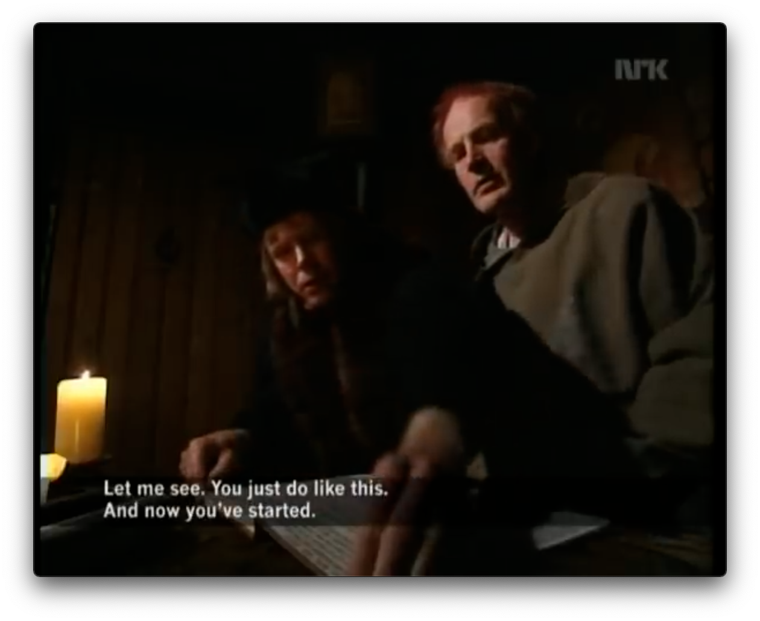
Why was this funny?
https://www.youtube.com/watch?v=pQHX-SjgQvQ&list=PPSV

Slide 10
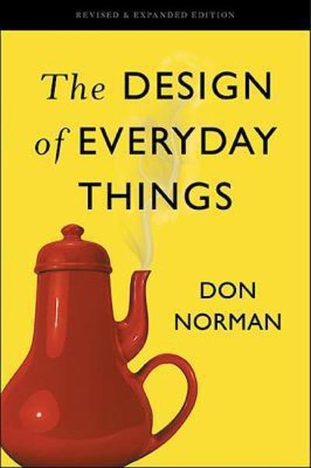
Learning (or discovering) how to use an interface
How we discover the operation of something (from Don Norman)
Affordances
Signifiers
Constraints
Mappings
User’s conceptual model

Slide 11
Affordance
Affordances are perceivable action possibilities
Affordance refers to the perceived and actual properties of a thing that determine how it is operated
Affordances are how an interface communicates non-verbally, telling you how to operate it

Slide 12
Returning to our joke about learning to use a book
Books have affordances
Pages are for flipping
Pages can be flipped forwards and backwards
Book covers can be opened, closed
It doesn’t need a sign, or a manual
It’s physical properties communicates these things

Slide 13
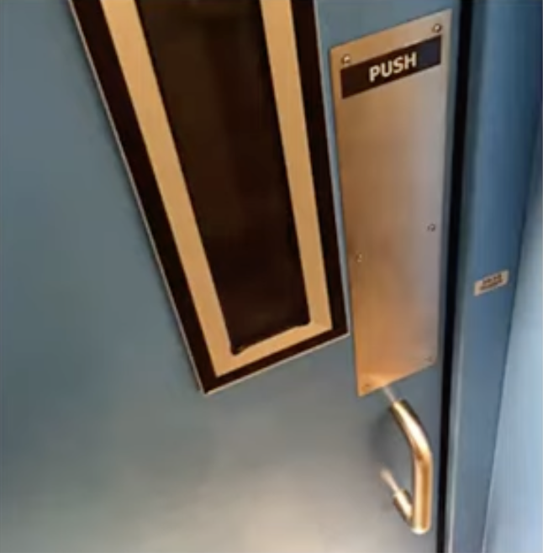
Applying the concept- Doors
Using the idea of an affordance (perceived action possibilities), what is going wrong here?

Slide 14
Returning to our door example
Doors have an affordance of being pushed or pulled open
Handles have an affordance of being grabbable and pullable
People will walk up to this ‘push’ door and try to pull it open
Affordances do not match the operation of the object
Need a sign to correct it

Slide 15
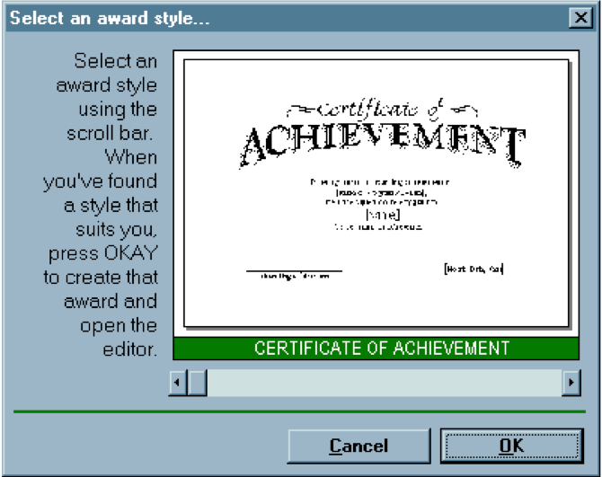
interface hall of shame example
Applying the concept of affordances, why is a scrollbar a poor choice for selecting from a list of options

Slide 16
interface hall of shame example
Scrollbars have a property (affordance) of being continuously draggable for continuous scrolling – smooth movement left/right
Not for discrete selection

Slide 17
Perceived vs actual affordances
We may perceive that something has an affordance, but it may not have it
Paper chair may look like you can sit on it, but it does not afford sitting
Fire hydrant may not look like it has an affordance for sitting- no flat surface- but it does afford sitting (not comfortably but….)
This is where things can go wrong in our interface design
I think I can click this, I think I can drag this, I think I can click and type here…. But I can’t
Anyone have any examples of this?

Slide 18
Hidden affordances
Chairs have a design that reveals an affordance of being able to sit on it- shape mirrors a human, seated body
But- you can stand on a chair to change a lightbulb
An object’s affordances can be revealed by what people do with it

Slide 19
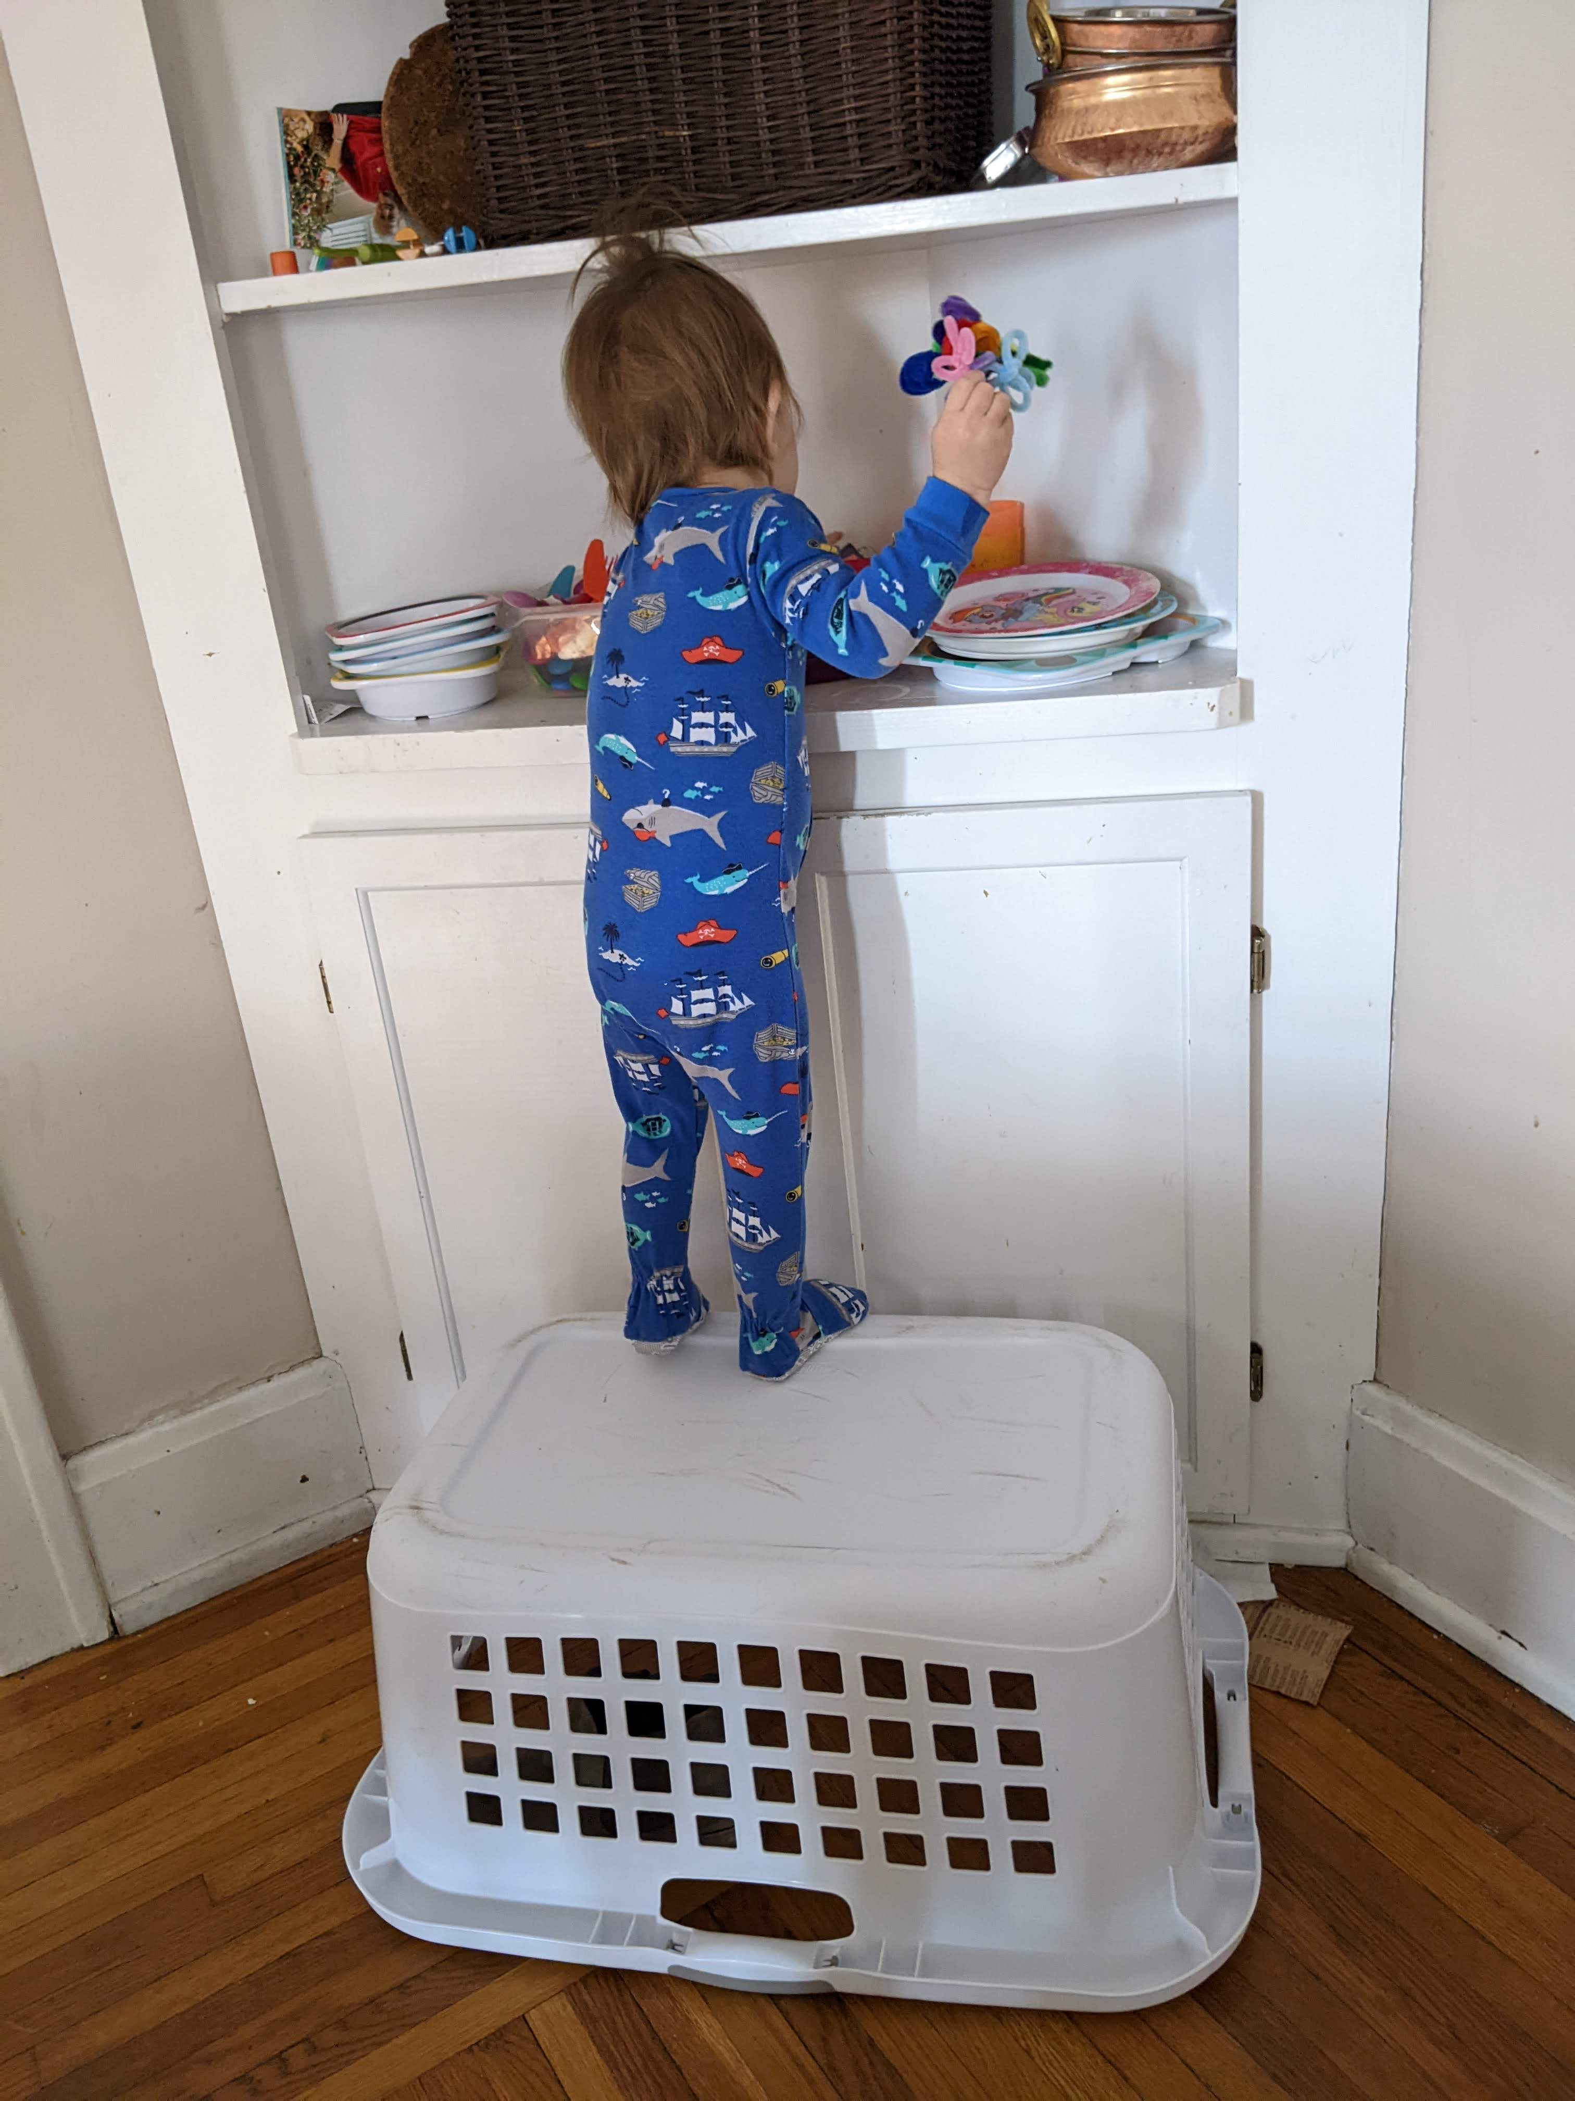
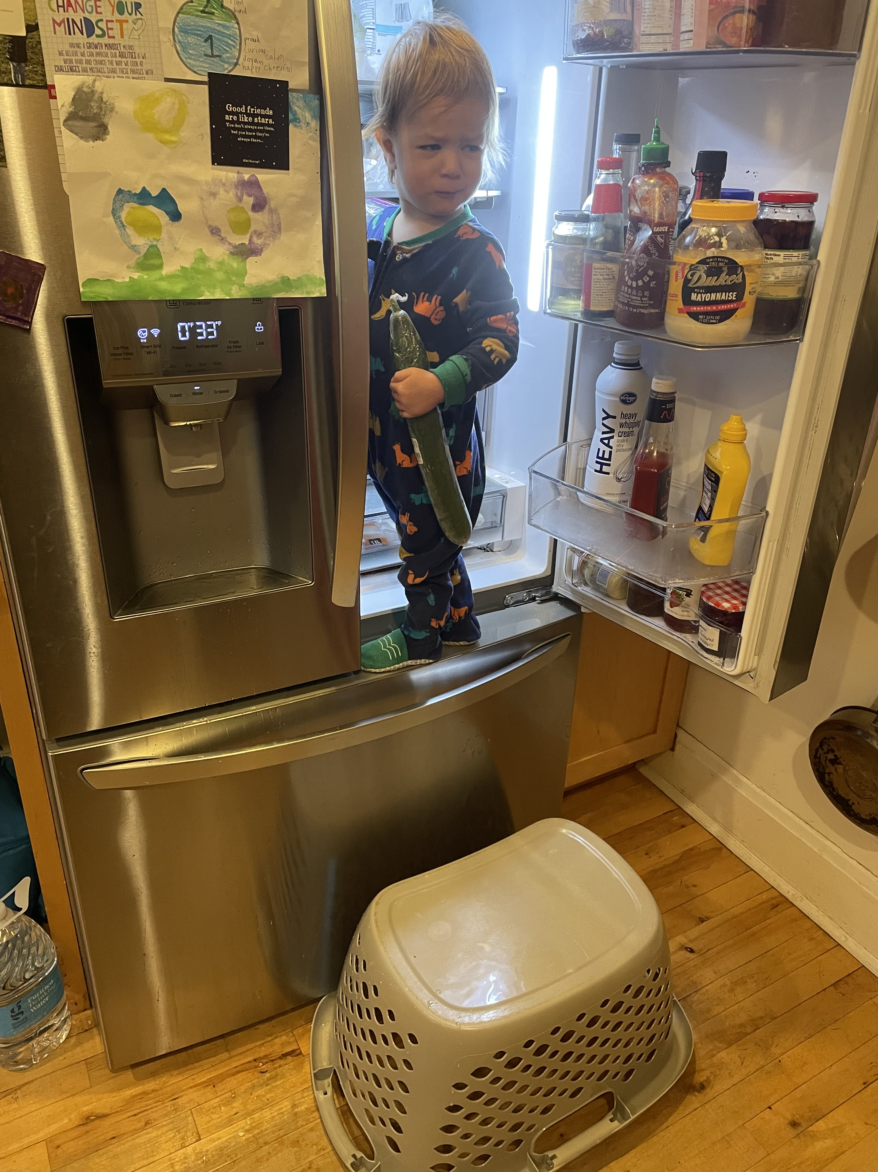
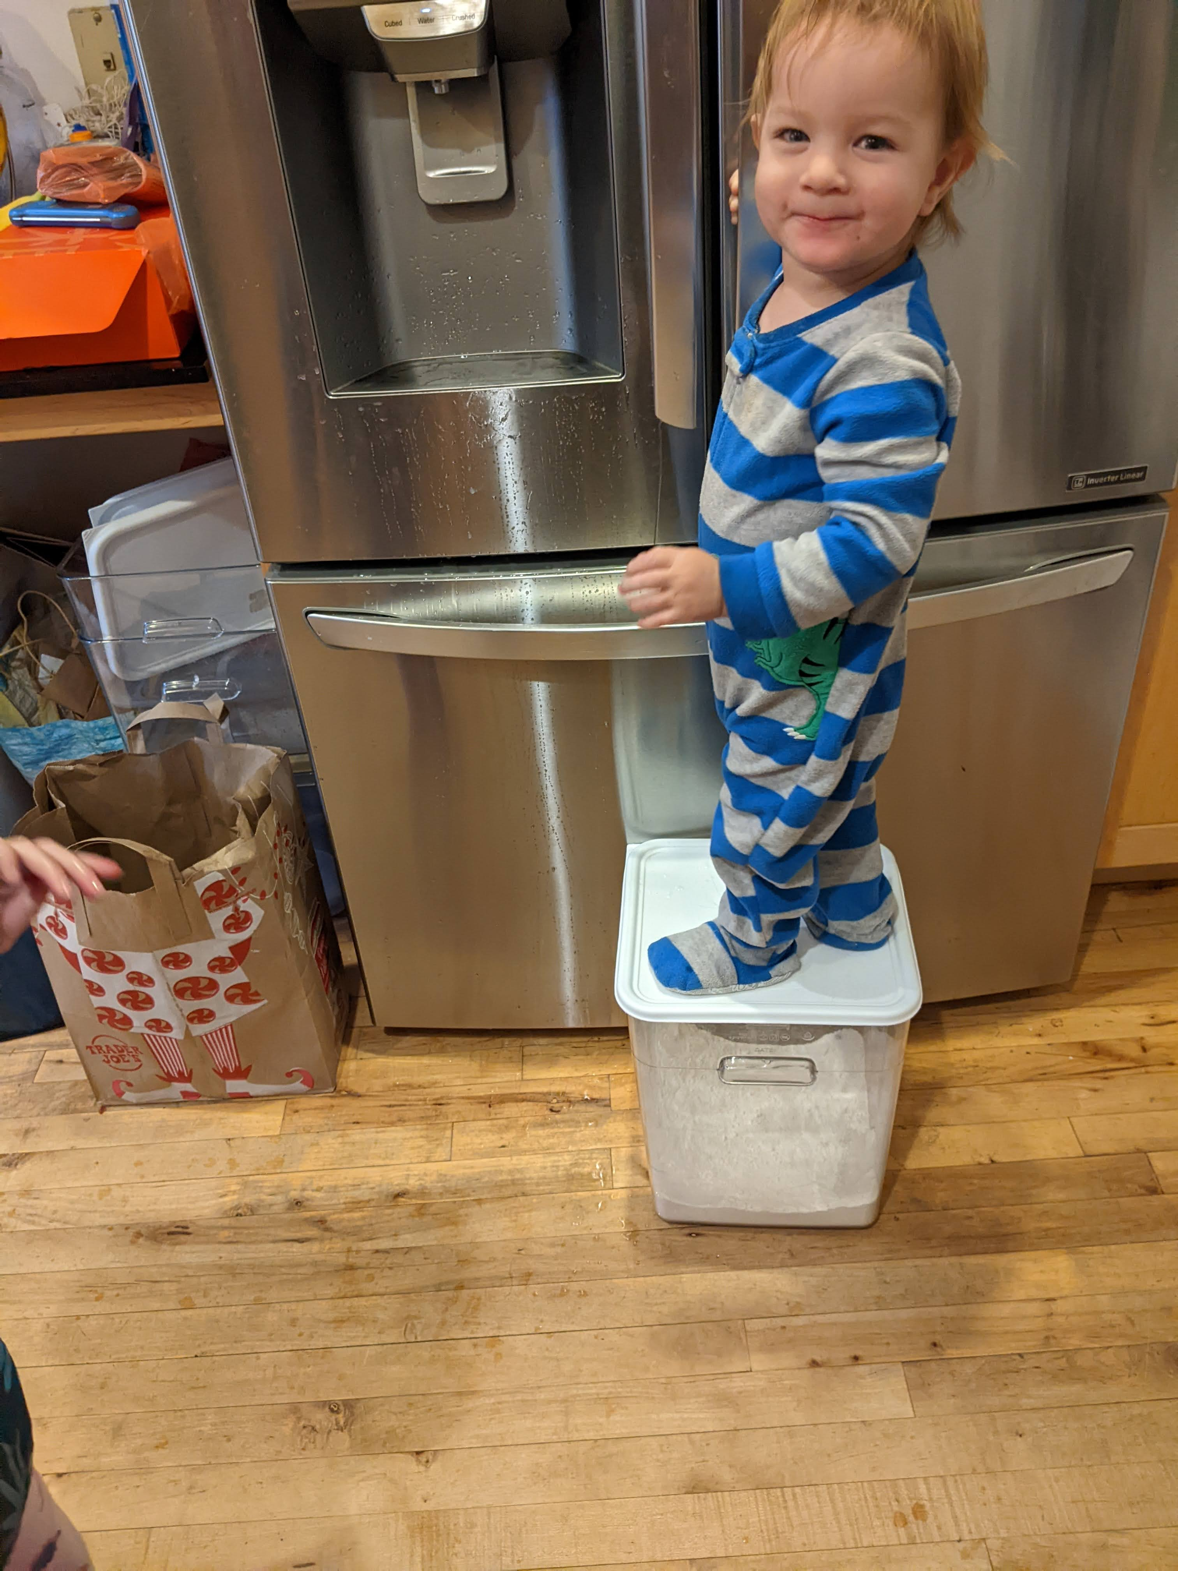
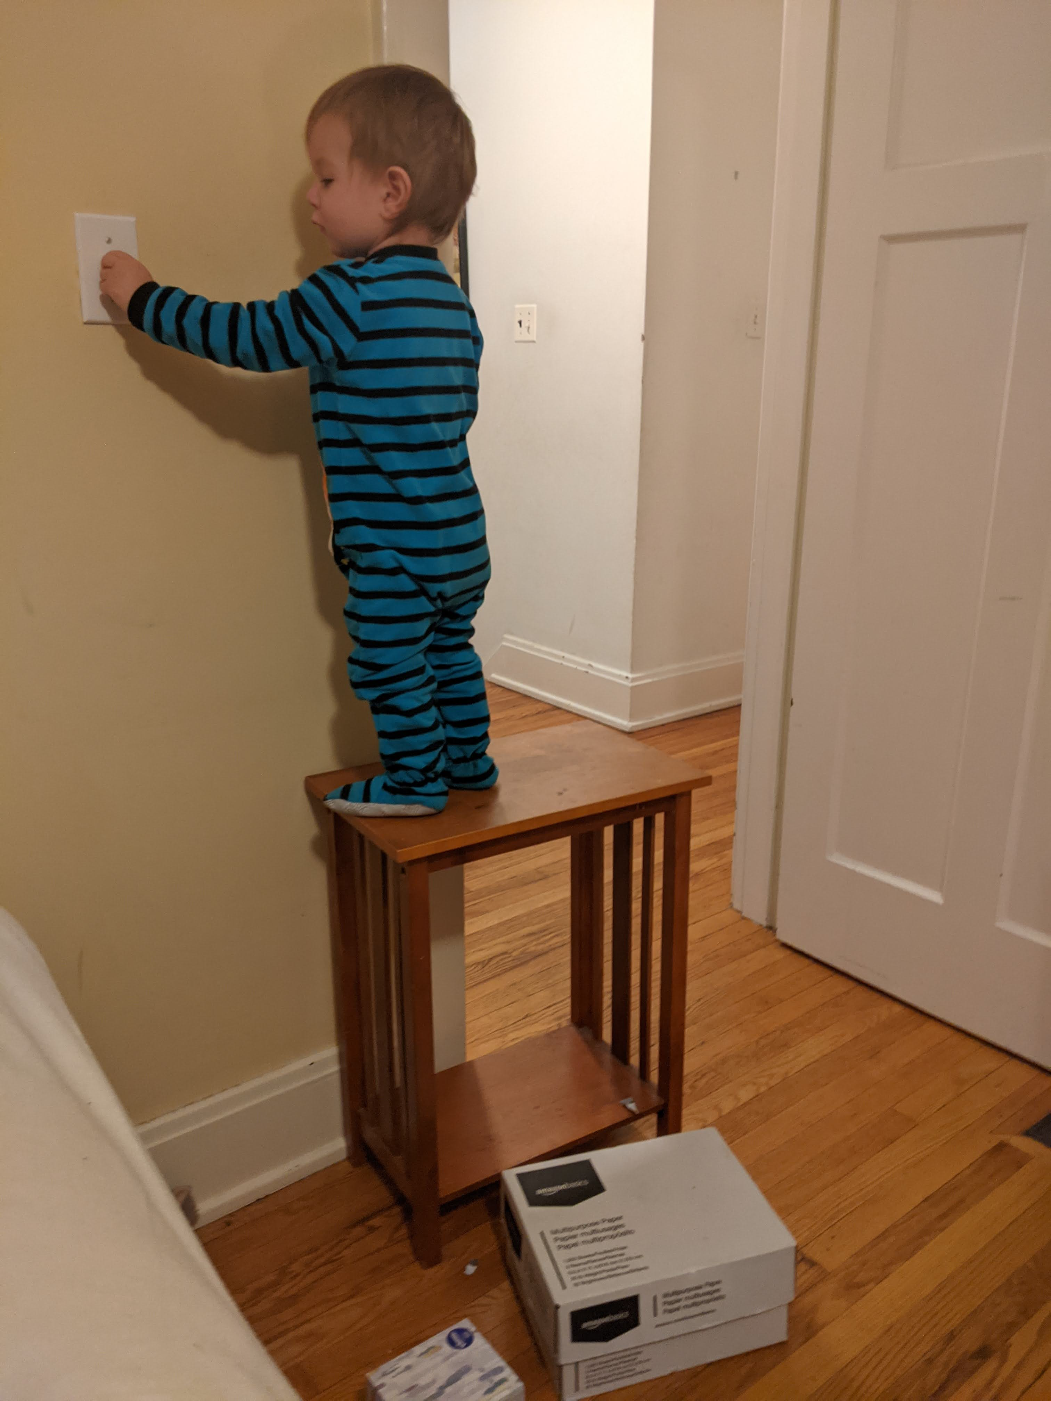
My kids…. Learning the physical world

Slide 20
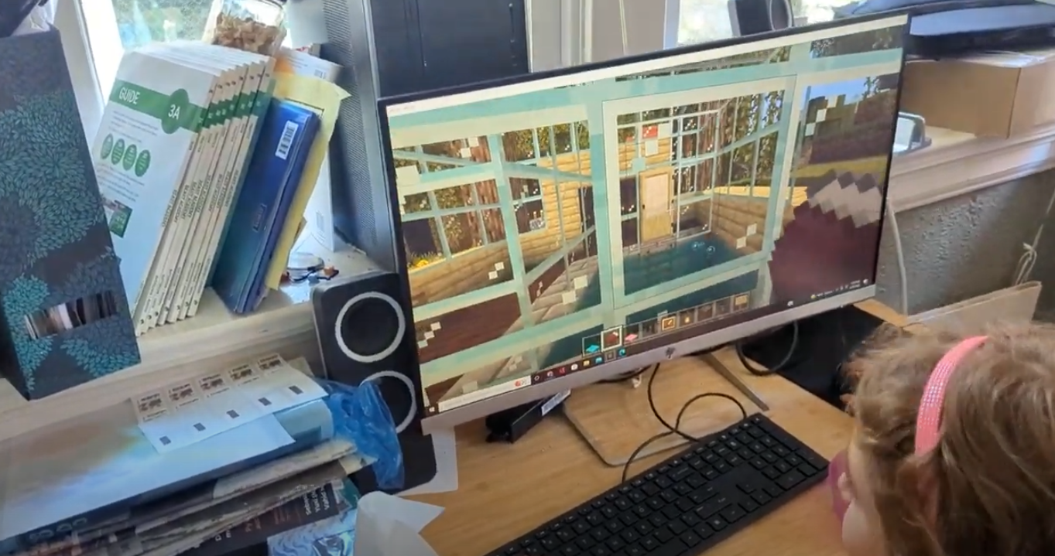
My kids… Learning about digital things

Slide 21
Affordances are learned
Affordances are rarely innate, we learn about them from experience
We have experience sitting on chairs, and we recognize the properties suitable for sitting
Same with door handles, book pages, scrollbars…..
You learn what the thing is capable of doing from lots of experiences with physical objects and digital interfaces

Slide 22
Learned, but also fundamental to the object
So, yes these are learned
But, also they have much to do with the actual properties of how something works
We learn that scrollbars are used to continuously scroll through content
But also, this is the actual property of how the scrollbar is able to behave

Slide 23
Recap- Affordance
Affordances are perceivable action possibilities
Affordance refers to the perceived and actual properties of a thing that determine how it is operated
Affordances are how an interface communicates non-verbally, telling you how to operate it
Handles have the affordance of being pullable
Scrollbars have the affordance of continuous scrolling

Slide 24
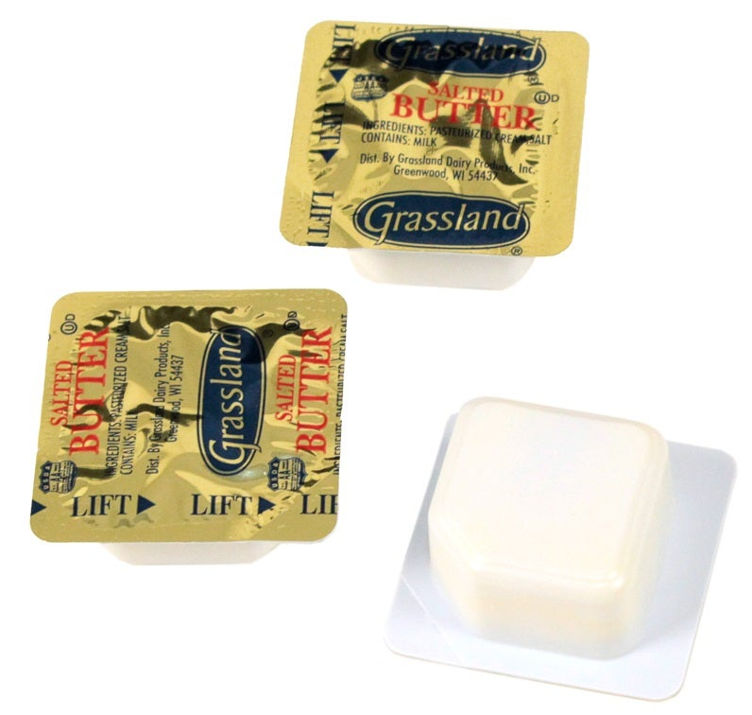
Signifiers
This butter package has affordances in its physical design
But it also directs the users in other ways
Text ”LIFT”
An arrow to show where to lift
Text to indicate what is inside
These additional directions to the users are signifiers

Slide 25
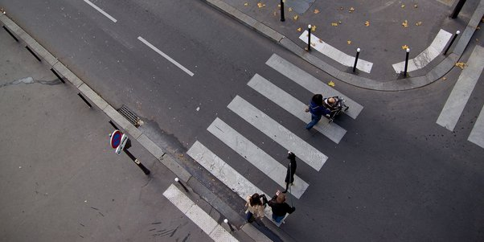
Signifiers
A signifier is a cue, a direction to the user
Signifier vs affordance
Consider this:
You can walk anywhere in the road
No physical barriers
The road is a flat surface that has the property of being walkable
You are being directed where to walk safely

Slide 26
When affordances are not enough to direct the user
A touch screen affords touching
But where to touch
And how to touch- press, fast press, swipe, drag…
A button UI elements affords clicking
But what happens when I click
If I click now, will I end up somewhere I shouldn’t be?
We need signifiers

Slide 27
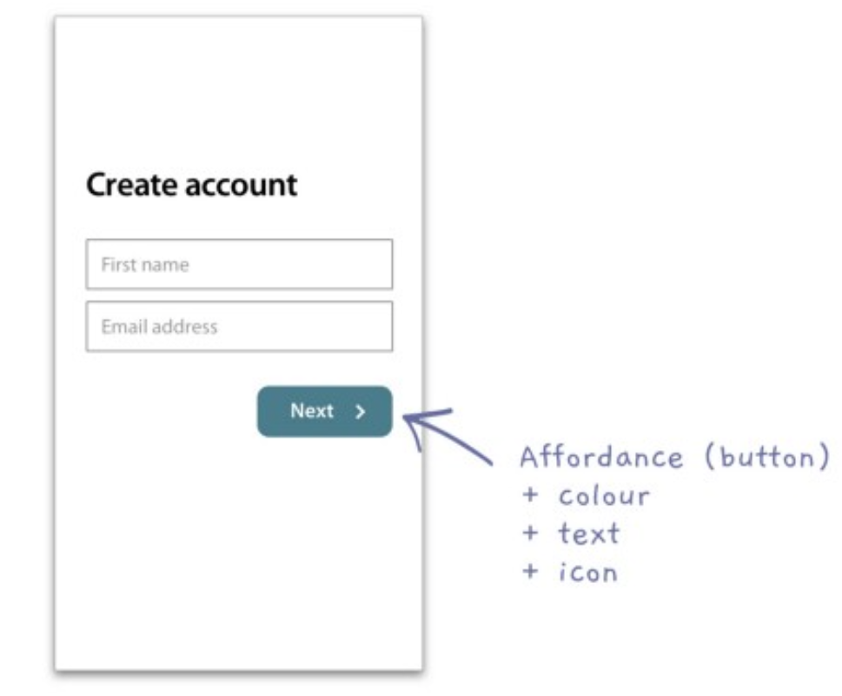
Sometimes you need a signifier
Button
Affordance of being clickable
Has a color signifier which highlights that is active
It has a word signifier which describes the action
And a forward arrow, indicating the direction this action will take you in through the interface
These properties together help the user know what to do

Slide 28
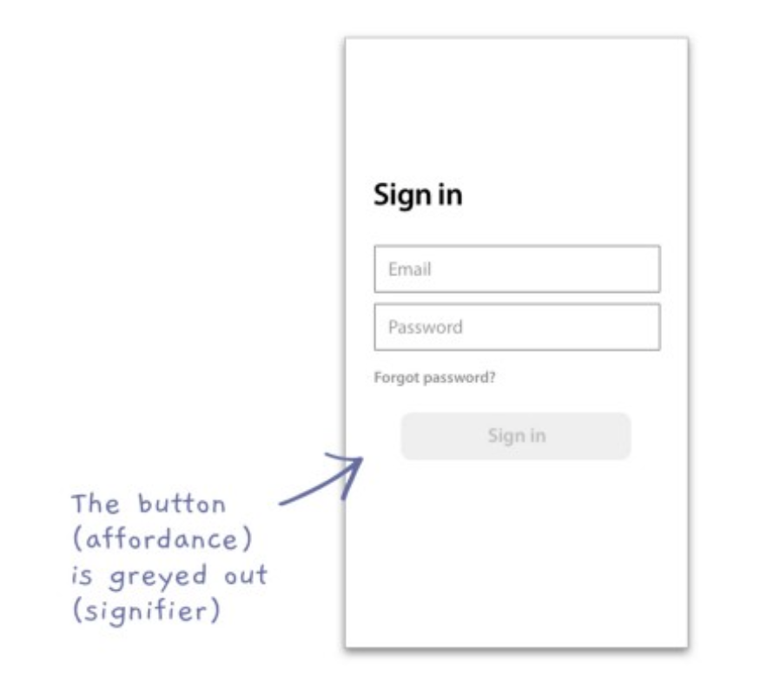
Signifiers
Directing the user what not to do
You can’t click here yet
https://medium.com/@h_locke/affordances-and-signifiers-82bd6f50fc1a

Slide 29
Video to help with the distinction
https://www.interaction-design.org/literature/topics/signifiers

Slide 30
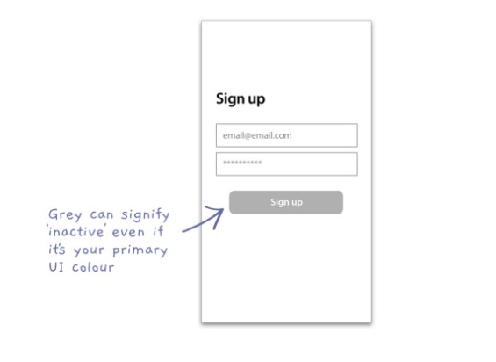
Ways you can confuse your user by mis-using signifiers and affordances

Slide 31
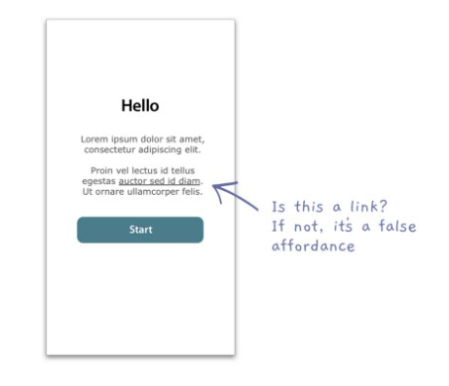
Ways you can confuse your user by mis-using signifiers and affordances

Slide 32
Constraints
Affordances
Signifiers
Constraints
Mappings
Feedback
User’s conceptual model of the system

Slide 33
What are constraints
Constraints are about limiting the range of interaction possibilities for the user, to
Simplify the interface
Guide the user to the appropriate next action

Slide 35
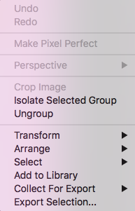

Slide 36
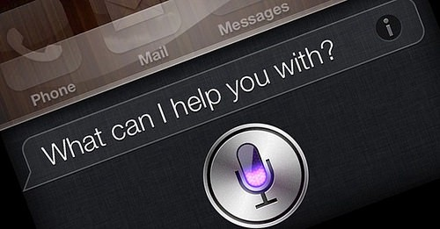
Constraint challenges
Conversational interaction or natural interaction
Hard to convey to someone what are the constraints
We feel unconstrained in how we interact through conversational interactions

Slide 37
Discoverability, learnability
Affordances
Signifiers
Constraints
Mappings
Feedback
User’s conceptual model of the system

Slide 38
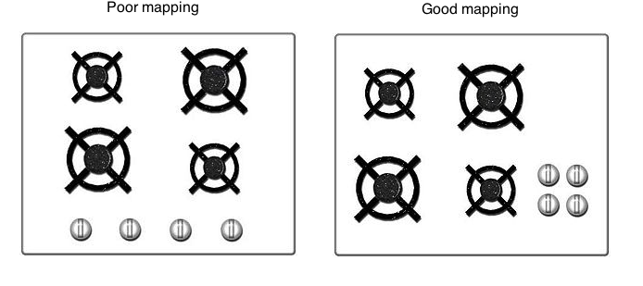
Mappings
How to communicate what an action will do
Considering the mapping – or relationship- from the controls and the impact real world
Which do you like better?

Slide 39
Mappings
How to communicate what an action will do
Considering the mapping – or relationship- from the controls and the impact real world

Slide 40
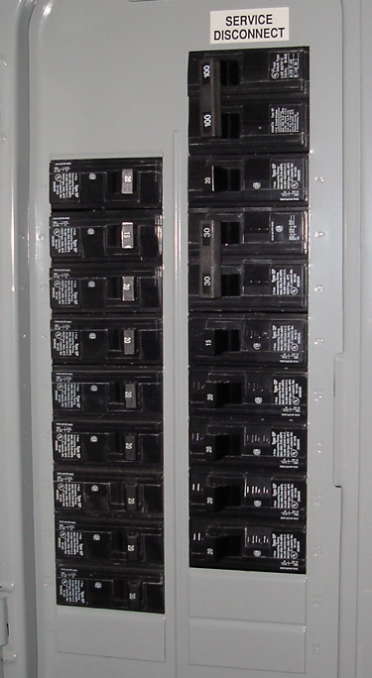
Bad mappings

Slide 41
Other examples
Placement of light switches and the actual lights in the room
No need for a sign, if you spatially map it to the room
Look at the light switches in this room…

Slide 42
The physical placement of elements maps to its function
Consider my car dashboard

Slide 43
Affordances
Signifiers
Constraints
Mappings
Feedback
User’s conceptual model of the system

Slide 44
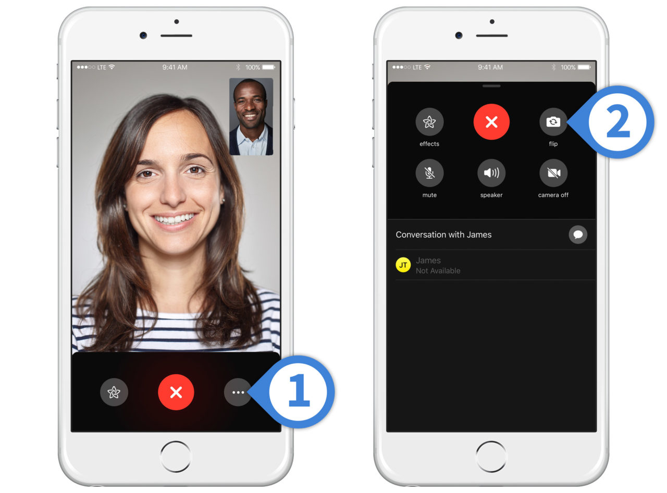
What is feedback?
Response- often visual, sometimes auditory- we get from performing an action
Serves as a confirmation that the action was performed
Anyone have examples of interfaces or controls with insufficient feedback
Did this work?
Did I press it?
Should I press it again?

Slide 45
Return to our learnabiity of a book
When I turn the page, I get lots of visual feedback that I have succeeded in accessing new content

Slide 46
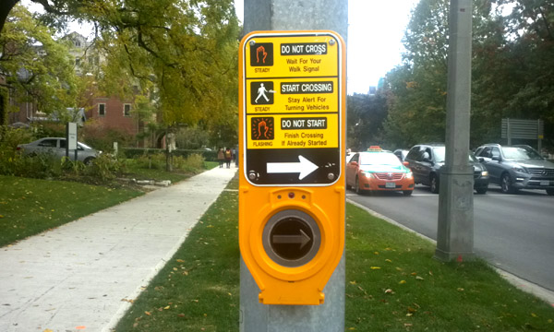
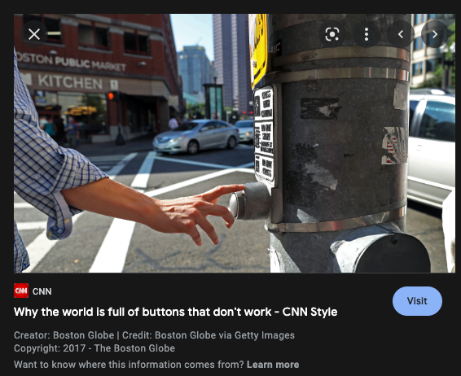
Some situations with lack of feedback
Pushing the up button in an elevator over and over
Pushing the walk button at a traffic stop over and over
Sitting at the light in your car- did it detect that I am here? Will it change?

Slide 47
Feedback- needs to be fast!
Studies- even 1/10 of a second can feel too slow
If people don’t get feedback, they’ll give up

Slide 48
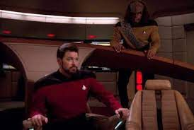
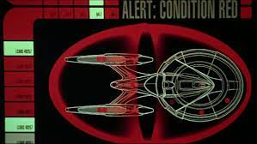
Feedback needs to be informative and not distracting
Indicator lights or sounds are good but
Don’t convey much
Distracting

Slide 49
What else helps with learnability? Consistency

Slide 50
Consistency
Consistency allows the user to transfer their existing knowledge easily to a new UI

Slide 51
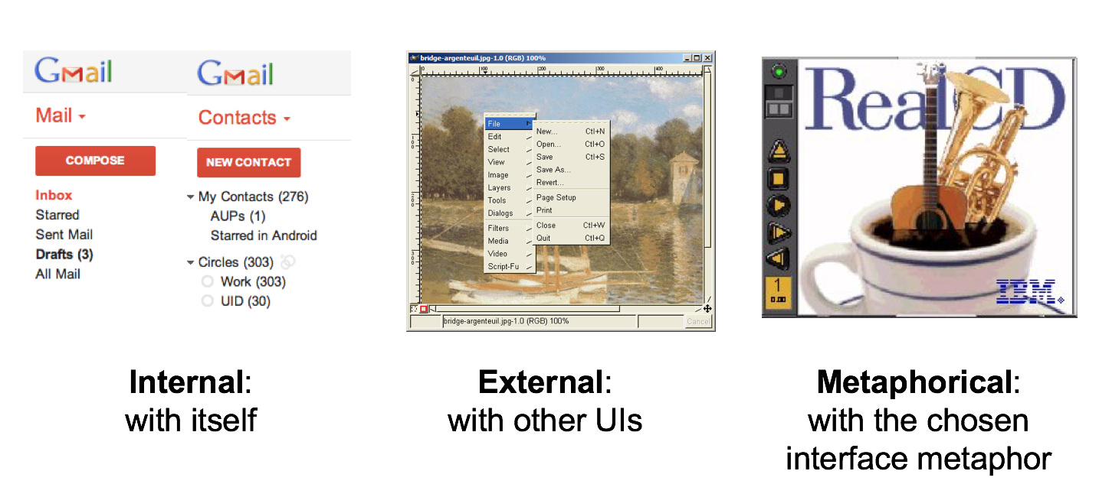
Kinds of Consistency

Slide 52
Your application’s navbar changes from one page to another. What kind of consistency is violated?
Internal consistency
External consistency
Metaphorical consistency
None of the above

Slide 53
Your application’s navbar changes from one page to another. What kind of consistency is violated?
Internal consistency
External consistency
Metaphorical consistency
None of the above

Slide 54

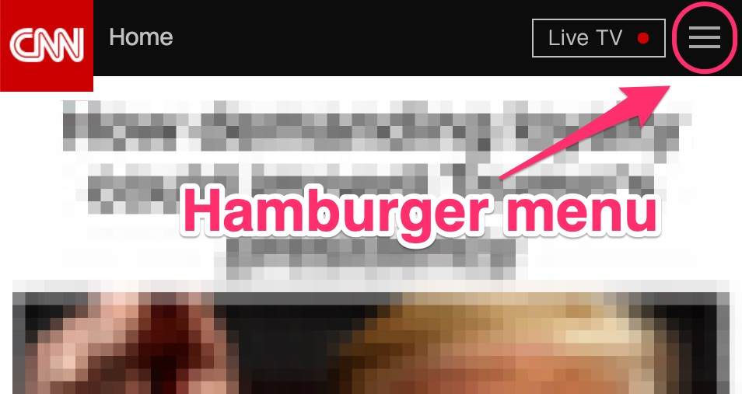
External consistency
People spend more time in other UIs
For them to learn your UI- good to use metaphors, symbols, layouts, interaction approaches that are consistent to other experiences

